Slide 1
Understanding the Background of Xilinx Alveo FPGA Implementation
AIHA-Intern-2023-NPU
Dongbeom Son / Wonbin Seo / Sumin Lee
bumin35@hanyang.ac.kr / kkyou123@hanyang.ac.kr / slbiog3025@hanyang.ac.kr
2023 aiha-intern

Slide 2
Table of Contents
1. FPGA
  FPGA Overview
  FPGA Architecture
  The basic Logic Cells
  Programmable Interconnection
  Block RAM
  DSP Block
  Configurable Logic Block in UltraScale Architecture
  Block RAM in UltraScale Architecture
  DSP block in UltraScale Architecture
2. DDR4 SDRAM
  Hierarchy
  DDR4 Memory Organization
  DRAM sizing & Addressing
  DDR4 Memory Accessing
  Micron DDR4 SDRAM
3. HBM DRAM
  Difference between HBM and other memories
  Disadvangates
  Vertex Ultrascale+ HBM
  Optimizing HBM Memory Controller
Notes:
Channel은 Bank로, Bank는 다수의 Memory Array들로 구성되어 있는 모습을 확인할 수 있다.

Slide 3
Table of Contents
4. Xilinx Alveo Card (U250)
  Overview
  Basic Alveo Architecture
  Alveo Architecture
  Inside the FPGA (XCU250)
5. Xilinx Alveo Card (U280)
  Overview
  Alveo Architecture
  Inside the FPGA (XCU280)
6. PCIe
  Overview
  PCI-e Layer
  PCI-e topology
  CCIX
7. Vitis HLS
  Overview
  Re-Architecting the Design Code
Notes:
Channel은 Bank로, Bank는 다수의 Memory Array들로 구성되어 있는 모습을 확인할 수 있다.

Slide 4
FPGA
Notes:
Channel은 Bank로, Bank는 다수의 Memory Array들로 구성되어 있는 모습을 확인할 수 있다.

Slide 5
FPGA overview
Field-Programmable gate arrays
  Programmable computer chip
  Can be programmed to implement any digital hardware circuit
Comparison to custom ASIC
  Lower non-recurring engineering cost and shorter time-to-market
  Allows hardware update
  Increased Area and cost
Usage
  Medium and small volume designs
  ASIC-prototyping
  High-frequency trading
  Wireless trading
  Embedded signal processing

Slide 6
FPGA architecture
FPGA key elements
  Basic Logic Cells
  Programmable interconnection
  Configuration technology
    SRAM configuration cell
  Programmable IO
    Possible to communicate with very wide variety of other devices
  Software to design and Program FPGA
    User describe desired function with hardware description language(HDL) and compiled using special software to program FPGA's configuration SRAM cells
Advanced features
  BRAM
  DSP Block

Slide 7
The basic logic cells
Configurable logic block
  Main resource for implementing general-purpose combinational and sequential circuits
  Logic elements grouped together in a slice
  Interconnect routing resources to connect the logic elements
Slice
  Smallest programmable unit of FPGA
  Contains LUTs, FFs, Multiplexers, Carry Logic and others
Look-Up Tables
  Fundamental logic element in FPGA
  All possible outputs are configured in SRAM, selected by Multiplexer
  K-input LUT can implement any K-input Boolean function by storing truth table

Slide 8
Programmable interconnection
Programmable Routing
  Over 50% of both the fabric area and the critical path delay of application
  Composed of pre-fabricated wiring segments and programmable switches
  By programming an appropriate sequence of switches to be on, any output from logic block can be connected to any input
Routing architecture
  Hierarchical routing
    Realize connection between higher-level module instantiating lower-level module with short wires
    Requires long wires at the upper-level interconnection
  Island-style routing
    Horizontal and vertical directed wire segments can be efficiently laid out

Slide 9
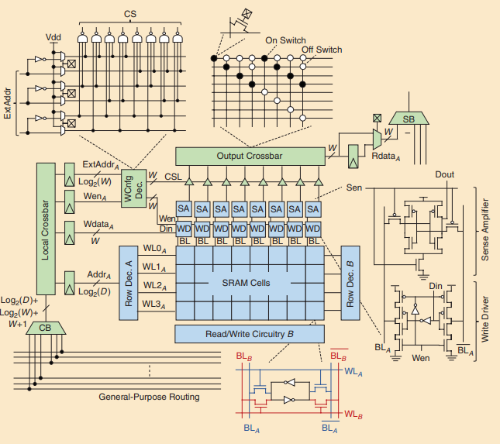
Block RAM
Block RAM History
  First on-chip memory elements in FPGA was FlipFlops in logic block
  As FPGA's logic capacity grew, required memory to buffer and re-use data on-chip
  Due to inefficiency of LUT based RAM, denser on chip storage BRAM was introduced
Block RAM architecture
  BRAM consists of an SRAM-based memory core with additional peripheral circuitry to orchestrate access to these cells for read/write

Slide 10
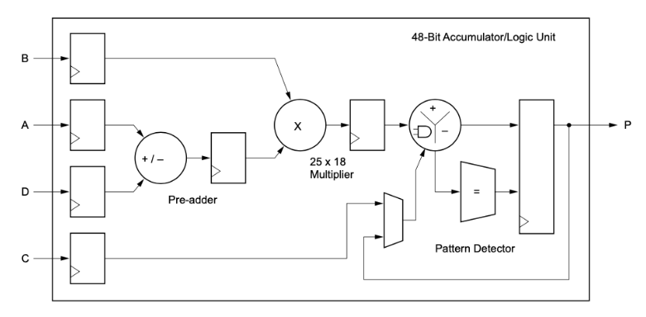
DSP Block
DSP Block history
  LUTs and Carry chains implement efficient adders
  Implementing multiplier with LUTs and Carry chains incurs a substantial area and delay penalty
  Adopted hard multiplier in FPGA
  Full featured DSP blocks targeting the communications and signal processing domain was introduced
Basic DSP Block Features
  Adder/Subtractor
  Accumulator
  Multiplier

Slide 11
DSP Block
DSP Block evolution
  High performance computing
    Adding native support for single precision floating point multiplication
  Low precision multiplication
    Increasing low-precision integer multiplication specifically for deep learning inference workload
    Use of low-precision fixed-point arithmetic instead of fp32 shows negligible or no accuracy degradation but greatly reduced hardware cost
    Required precision is model dependent and FPGAs have emerged as an attractive solution for DL inference due to ability to implement custom precision datapath

Slide 12
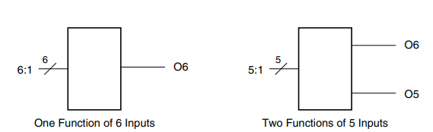
Configurable Logic Block in UltraScale Architecture
UltraScale Architecture CLB contains one slice
  Each slice provides eight 6-input LUTs and sixteen flip-flops
  LUTs are organized as a column with an 8-bit carry chain per CLB
  Wide-function multiplexers to create any function of 7,8 or 9 inputs
SLICEL and SLICEM
  The LUT in SLICEM can be configured as a 64-bit distributed RAM, or 32-bit shift register
Look-Up Table
  Six independent inputs and two independent ouputs
  Can implement
    Any six-input Boolean function
    Two five-input Boolean functions sharing common input
    Two Boolean functions three inputs or less

Slide 13
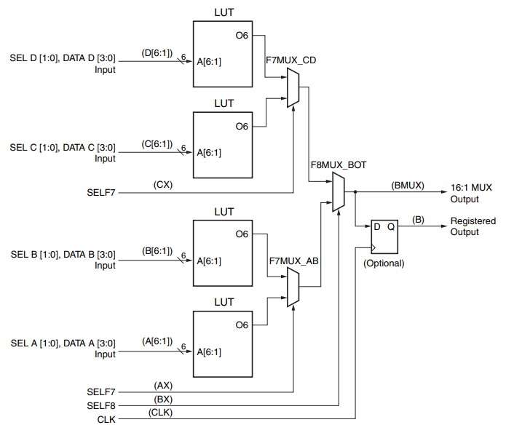
Configurable Logic Block in UltraScale Architecture
Multiplexers
  LUTs and associated multiplexers can implement wide-input multiplexers
    4:1 multiplexers using one LUT
    8:1 multiplexers combining 2 adjacent LUTs
    16:1 multiplexers combining 4 adjacent LUTs
    32:1 multiplexers combining 8 LUTs

Slide 14
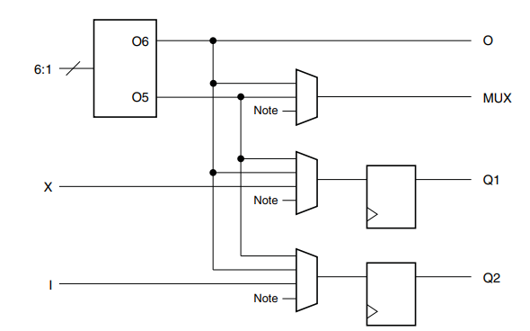
Configurable Logic Block in UltraScale Architecture
Storage Elements
  16 storage elements per CLB slice(2 per LUT)
  Can be configured as either edge-triggered D-type flip-flop or level sensitive latches.
  Two storage elements of one LUT have same input options
    Two LUT outputs
    Direct input from CLB
    Carry XOR result or cascade output
    Output of wide multiplexer
  8 storage elements share clock and set/reset inputs
  4 storage elements share Clock Enable signal

Slide 15
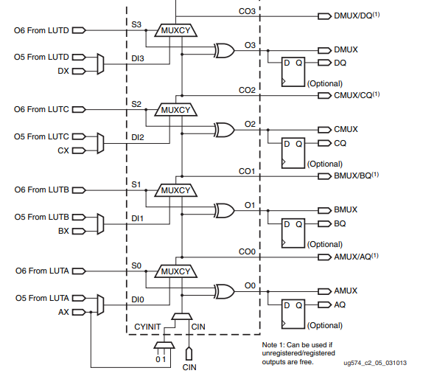
Configurable Logic Block in UltraScale Architecture
Dedicated fast lookahead carry logic performs fast arithmetic addition and subtraction
  A slice has a single 8-bit carry chain
  Carry chains are cascaded to form wider add/subtract logic
  XOR gate provided for adding subtracting the operands with selected carry bit

Slide 16
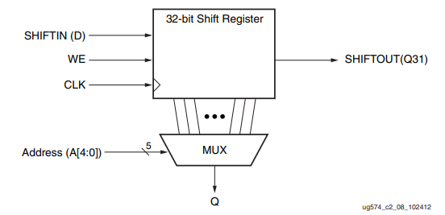
Configurable Logic Block in UltraScale Architecture
Distributed RAM
  LUTs in SLICEM can be implemented as a synchronous RAM resource
  Multiple LUTs can be combined to store larger amounts of data
  Multiple SLICEMs can be combined to create larger memories
  Synchronous write resources. Write clock is from dedicated SLICEM input LCLK that is independent of clocks for the storage elements.
  Distributed RAM can be configured as Single-port, Dual-port, and Simple dual-port
Shift Registers
  LUTs in SLICEM can configured as a 32-bit shift register without using the flipflops.
  Each LUT can delay serial data from one to 32 clock cycles.

Slide 17
Block RAM in UltraScale Architecture
Block RAM
  36Kb block RAM contains two independently controlled 18Kb RAMs
  BRAM data output blocks are cascadable to enable deeper memory implementation
  Provides sleep mode for power saving and selectable write mode operation
True dual-port
  True dual-port memories have two completely independent access ports.
  Both ports are interchangeable
  Data can be written to either or both port and can be read from either or both ports.
  Each write and read operation is synchronous
  Each port has its own address, data in, data out, clock, clock enable and write enable
Simple dual-port
  Doubled maximum port width, port width can be independent for each port
  One port is designated as write port and other port as the read port

Slide 18
Block RAM in UltraScale Architecture
Single Port
  Maximum port width doubled to 72bits
  Read/Write from same port
Write mode
  Write first mode
    Input data is simultaneously written into memory and stored in data output
  Read first mode
    Data previously stored at the write address appears on the output latches
  No change mode
    Output remain unchanged during a write operation

Slide 19
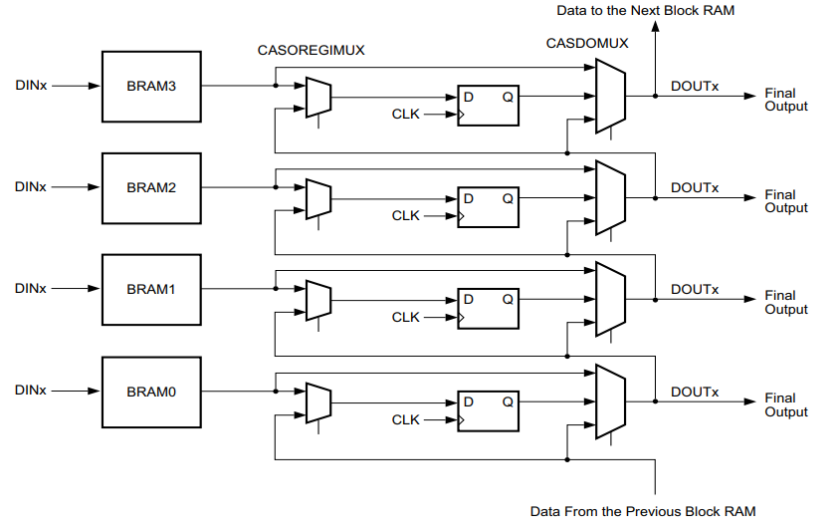
Block RAM in UltraScale Architecture
Cascade Block RAM
  Provide the capability to cascade data out from one RAMB36 to the next RAMB36 to make a deeper block RAM
Block RAM Error Correction Code
  Block RAM support a 64-bit ECC implementation.
  Detects single- and double-bit errors in block RAM-read out.
Power Gating of Unused Block RAMs
  Power gating is enabled on every 18Kb block that is not instantiated in the design.

Slide 20
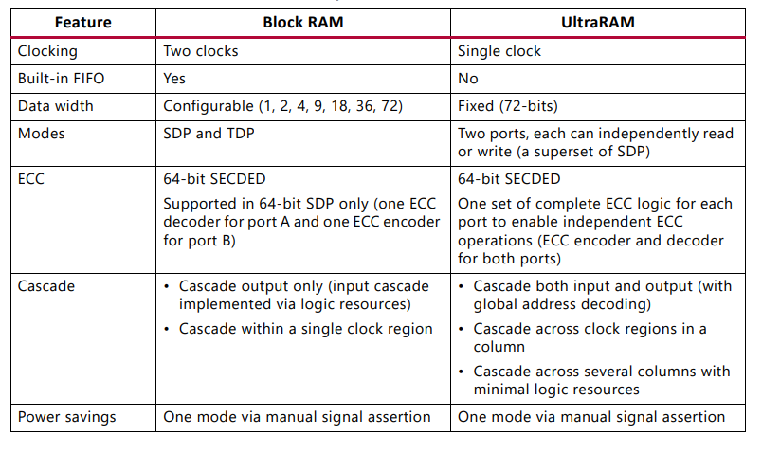
Block RAM in UltraScale Architecture
UltraRAM
  Additional on chip memory supported on UltraScale Architecture
  288Kb, single-clock, synchronous memory block

Slide 21
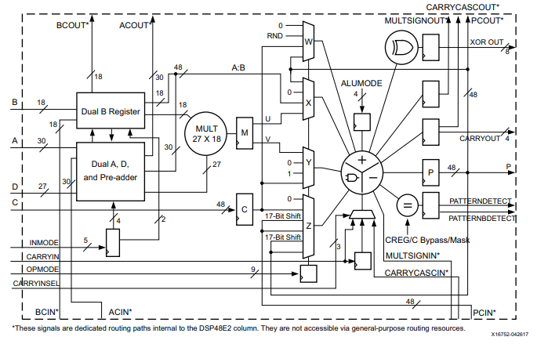
DSP block in UltraScale Architecture
DSP48E2
  DSP slice in the UltraScale architecture is defined using DSP48E2 primitive

Slide 22
DSP block in UltraScale Architecture
DSP48E2 Functionality
  27 x 18 two's complement multiplier with dynamic bypass
  27-bit pre-adder
  48-bit accumulator can be cascaded to build 96-bit and larger accumulators, adders and counters
  Single-instruction-multiple-data arithmetic unit / dual 24-bit or quad 12-bit
  48-bit logic unit for bitwise operation
  Pattern detector
  Optional pipeline registers

Slide 23
DDR4/SDRAM
Notes:
Channel은 Bank로, Bank는 다수의 Memory Array들로 구성되어 있는 모습을 확인할 수 있다.

Slide 24
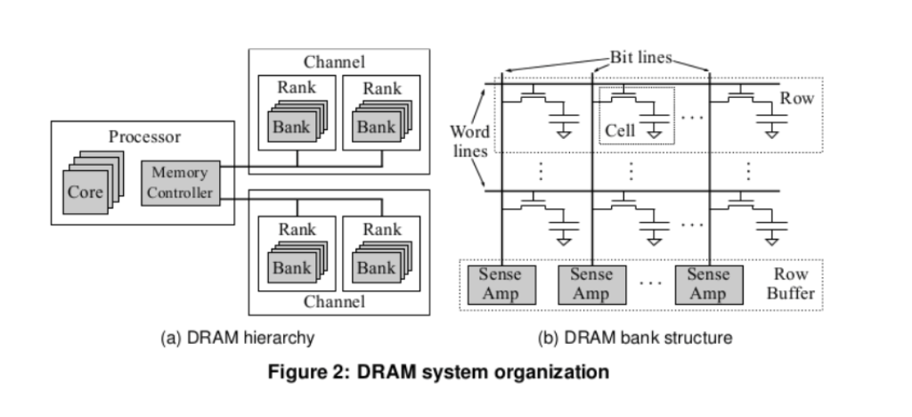
DDR4 SDRAM
Hierarchy
Notes:
Channel은 Bank로, Bank는 다수의 Memory Array들로 구성되어 있는 모습을 확인할 수 있다.

Slide 25
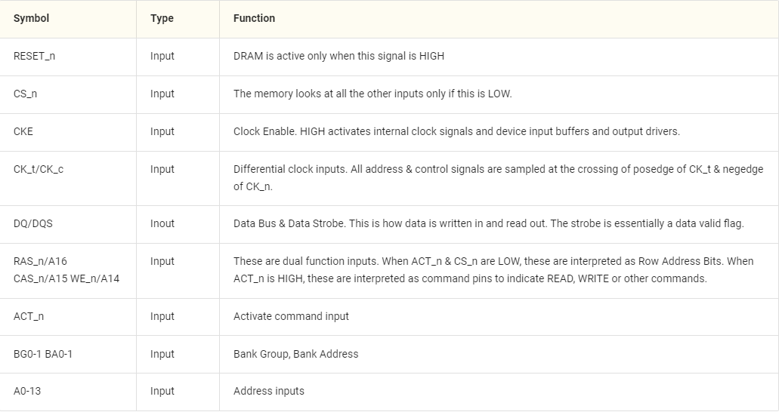
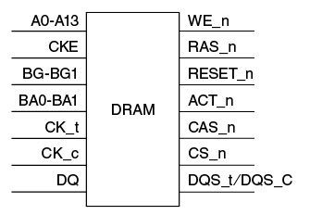
DDR4 SDRAM
DDR4 Memory Organization
  Top level: Memory Controller(Channel)

Slide 26
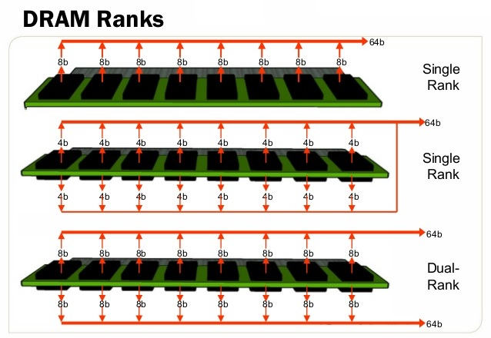
DDR4 SDRAM
DDR4 Memory Organization
  Rank (Depth Cascading)
    Highest logical unit and is typically used to increase the memory capacity of your system
    Single, Dual are divided according to the number of Chip Select signals (CS_n)

Slide 27
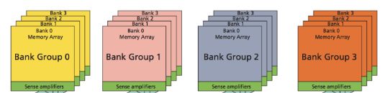
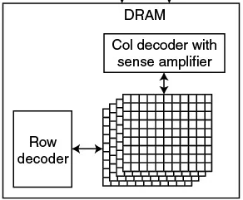

DDR4 SDRAM
DDR4 Memory Organization
  When Read , it needs Address → This Address is logical address → Translate to Physical address
  Bank Group: A collection of Banks
  Bank: A collection of Memory Arrays
  Memory Array: A collection of DRAM Cell
  Column width = DQ data bus, classified as x4, x8, x16
Notes:
Bank group & Bank가 식별, Address의 Row는 Memory Array의 한 파트 활성화, “Word Line” → Memory Array로부터 Sense Amplifier에 데이터 read
이후, Column Address는 Sense Amplifiers에 load된 word의 일부분을 read, width of the Column: "Bit Line“ 뒤에서 다시 언급하는 게 좋다

Slide 28
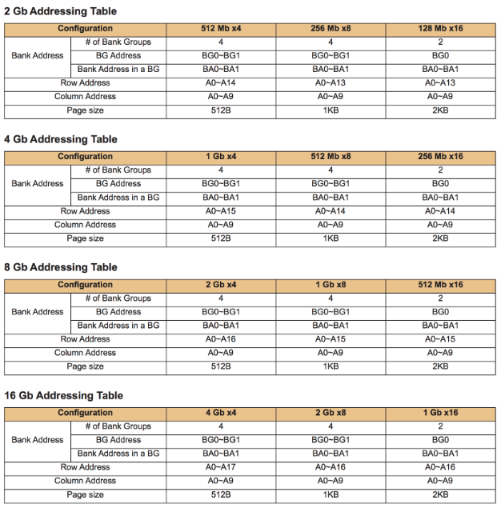
DDR4 SDRAM
DRAM sizing & Addressing
  Specified in JEDEC spec, 2G, 4G, 8G, 16G are available
The difference between 2G, 4G, 8G, 16G is # of row addresses
DDR4 DRAMs are available in 3 width (# of Data Pins)
  x4, x8, x16: DQ[3:0], DQ[7:0], DQ[15:0]
  Read operation as burst 8 mode (Mode to increase/decrease addresses sequentially and read/write large amounts of data)
Notes:
Column address is fixed to A0 – A9, $2^{10}=1K$
Page size: 각 Row가 활성화 되었을 때 Sense Amplifier에 로드되는 비트의 수
Column width * Column address = Sense Amplifier
1K * x8(8 bits) = 8K bits = 1K Bytes
Address를 순차적으로 증가/감소시키며 다량의 데이터를 read/write 하는 모드

Slide 29
DDR4 SDRAM
DDR4 Memory Accessing
  Burst oriented read/write operation, select location & burst length of 8
  Read/Write: 2-step operation
    Begins with ACTIVATE (ACT_n & CS_n are low), following RD or WR command
  RAS (Row Address Strobe (check signal)): Address bits registered ACTIVATE command are used to select BankGroup (BG0-BG1), Bank (BA0-BA1) and Row (A0-A17) to be activated
  CAS (Column Address Strobe (check signal)): Address bits registered Read/Write command are used to select starting column location for the burst operation
  Each bank has only one set of Sense Amps. Before read/write to a different row in the same bank can be performed, current open row must de-activated using a PRECHARGE command, it causes the data in the Sense Amps to be written back into the row.
  RDA (Read with Auto-Precharge), WDA (Write with Auto-Precharge): Auto precharge when read/write operation is over
Notes:
한글 구성

Slide 30
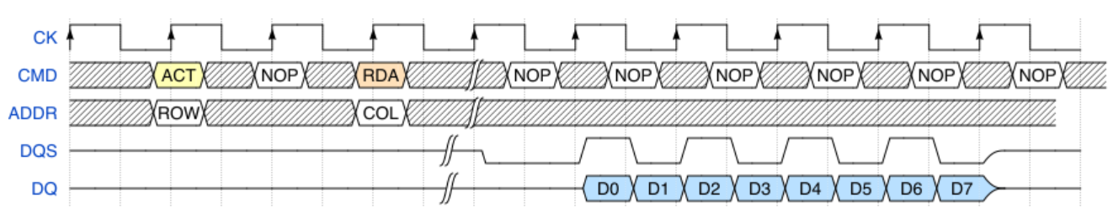
DDR4 SDRAM
Accessing Operation
  Read
  ACT command, with value on the address bus currently indicates the row address
  RDA (Read with Auto-Precharge) issued, with value on the address bus during currently is the column address.
  RDA command tells the DRAM to automatically PRECHARGE the bank after the read is over
Burst length 8

Slide 31
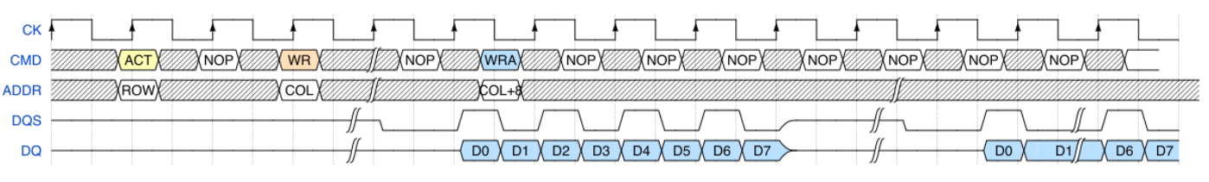
DDR4 SDRAM
Accessing Operation
  Write
  Activates a ROW
  Two WRITE commands are issued, 1) To address COL 2) COL + 8 (The example has 2x8 burst length)
    *Second write operation doesn’t need ACTIVATE before – Row we intend to write to is already active in
    Sense Amps. First command WR leaves row active, Second command WRA de-activates row when write
    completes

Slide 32
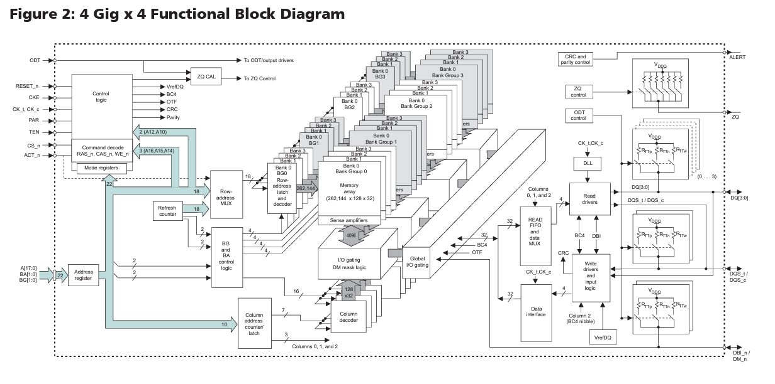
DDR4 SDRAM – Micron DDR4 SDRAM
Bank Addresses
Inputs

Slide 33
HBM
Notes:
Channel은 Bank로, Bank는 다수의 Memory Array들로 구성되어 있는 모습을 확인할 수 있다.

Slide 34
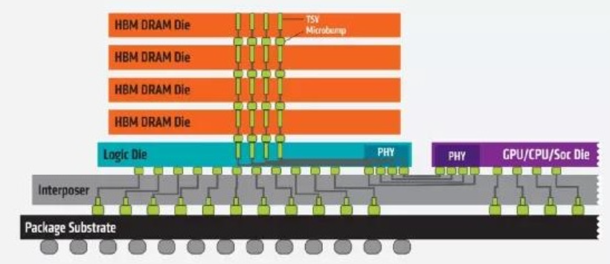
HBM DRAM
HBM (High Bandwidth Memory)
  Standardized stacked memory, providing wide channels for data, both within the stack and between the memory and logic
Notes:
Channel은 Bank로, Bank는 다수의 Memory Array들로 구성되어 있는 모습을 확인할 수 있다.

Slide 35
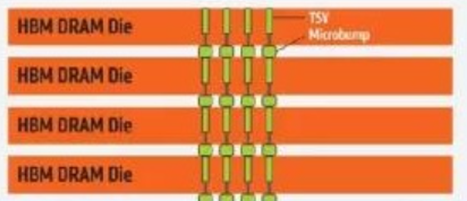
HBM DRAM
Stacked with multiple layers
  Higher transmit bandwidth
  Smaller size of DRAM
  Higher efficiency
TSV: Through Silicon Via, Connection of DRAM die
Each DRAM die: 2 x 128bits Channels
Total HBM Memory bit width: 2 x 128bits x 4 layers = 1024bits (DDR4 has 64bit width)
CPU/GPU has 4 HBM Memories: total 4096bits
Notes:
Channel은 Bank로, Bank는 다수의 Memory Array들로 구성되어 있는 모습을 확인할 수 있다.

Slide 36
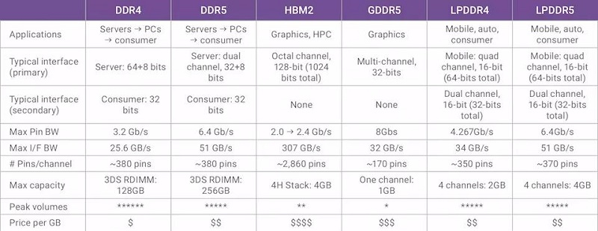
HBM DRAM
Difference between HBM and other memories
    Very large bandwidth of interface
    Since Main Chip and HBM are so close → Can get higher transmission efficiency
Notes:
Channel은 Bank로, Bank는 다수의 Memory Array들로 구성되어 있는 모습을 확인할 수 있다.

Slide 37
HBM DRAM
Disadvantages of HBM
    Poor Flexibility: Lack of flexibility in system collocation, fixed specification with DDR, hard to change
    If HBM is configurative → Cost issue
    Small Capacity:
      Memory capacity more limited than DDR (HBM package has 8layers of DRAM die x 8Gbit = 8GB, even supercomputer have 4 HBM packages, 32GB)
      Ridiculously low capacity compared to DDR (For a supercomputer, can also have a capacity of 12TB)
      Can use HBM & DDR together, HBM for high-bandwidth/small capacity, DDR for low-bandwidth/large capacity
Notes:
Channel은 Bank로, Bank는 다수의 Memory Array들로 구성되어 있는 모습을 확인할 수 있다.

Slide 38
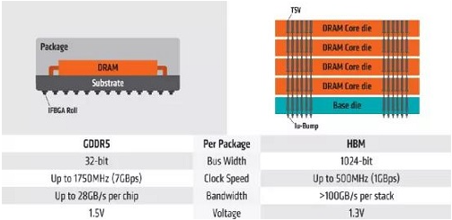
HBM DRAM
Disadvantages of HBM
    High Access Latency (Why is it not applied to CPU main memory PC)
      Similar to DDR for FPGA equipped with HBM
      DDR: CL (CAS latency) for memory latency
      (Waiting time between when read command issued and data is read)
      - With ultra wide interconnection width, transmission frequency of HBM cannot be too high
Lower than DDR
Notes:
CL: 얼마나 메모리 내의 데이터를 빨리 읽는가?

Slide 39
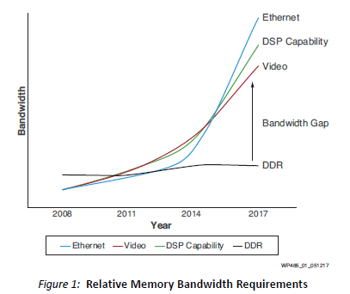
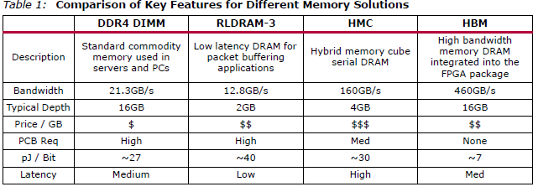
Xilinx HBM DRAM
Virtex Ultrascale+ HBM
                Providing the required transfer bandwidth between the FPGA and memory
                Bandwidth-critical applications, a new approach to DRAM storage required
Problem solving by removing the PCB from the equation
Notes:
Channel은 Bank로, Bank는 다수의 Memory Array들로 구성되어 있는 모습을 확인할 수 있다.

Slide 40
Xilinx HBM DRAM
Technology
  Key technology: Silicon stacking – improving in bandwidth
  HBM-enabled FPGA: External DDR4 used is a function of capacity requirements, not bandwidth
    Using fewer DDR4 components, saving PCB space & power
    No external memory is needed
Notes:
Channel은 Bank로, Bank는 다수의 Memory Array들로 구성되어 있는 모습을 확인할 수 있다.

Slide 41
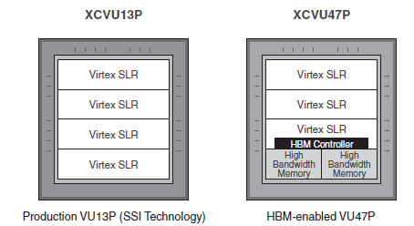
Xilinx HBM DRAM
Difference between SSI technology FPGA and HBM-Enabled FPGA
Differences are HBM controller and HBM
Notes:
Channel은 Bank로, Bank는 다수의 Memory Array들로 구성되어 있는 모습을 확인할 수 있다.

Slide 42
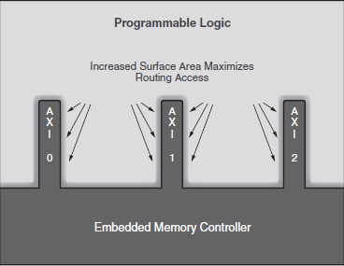
Xilinx HBM DRAM
Optimizing HBM memory controller
  Extended AIX interface (User connect to memory controller)
    For existing IP interfaces, the total bandwidth is sufficient to transmit and receive data
    However, in the case of HBM, the bandwidth is large, so a new type of interface needs to be structured.
Increases the surface area of the interface
Greatly increasing the available interconnect for the user’s AXI interface
Notes:
Channel은 Bank로, Bank는 다수의 Memory Array들로 구성되어 있는 모습을 확인할 수 있다.

Slide 43
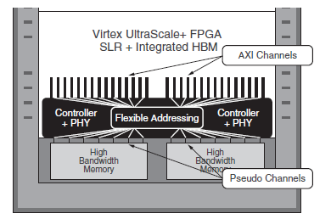
Xilinx HBM DRAM
Optimizing HBM memory controller
  Flexible Addressing
    HBM stack architecture segments the memory address space into pseudo channels, meaning that any given set of HBM DQ bits are allocated to a specific address region of the memory
    There are limitations that HBM stacks as a single contiguous memory, or partition them across pseudo channel boundaries
    To overcome, including AIX switch network, which routes memory reads and writes from any source AXI interface to any HBM pseudo channel based on address: Flexible Addressing
Notes:
HBM 스택 아키텍처는 메모리 주소 공간을 의사 채널로 분할한다. 이는 주어진 HBM DQ 비트 세트가 메모리의 특정 주소 영역에 할당된다는 것을 의미
HBM 스택을 단일 연속 메모리로 취급하거나 유사 채널 경계를 넘어 분할하려는 경우에는 이 제한
내장 메모리 컨트롤러 내부에 AXI 스위치 네트워크를 포함시켰다. 이 스위치 네트워크는 주소를 기반으로 소스 AXI 인터페이스에서 HBM 유사 채널로 메모리 읽기 및 쓰기를 라우팅합니다. 이 기능은 모든 사용자 AXI 인터페이스가 모든 HBM 메모리 주소에 액세스할 수 있도록 허용하기 때문에 유연한 주소 지정이라고 합니다.

Slide 44
Xilinx HBM DRAM
Benefits of Flexible Addressing
  Gives users full control over how the HBM stacks are addressed
  Allows designers to connect using the most convenient AXI interface based on timing closure for the design
  Provides a massive reduction in programmable routing resources
  Allows designers to use AXI interfaces more efficiently than the pseudo channels would otherwise allow
Notes:
Channel은 Bank로, Bank는 다수의 Memory Array들로 구성되어 있는 모습을 확인할 수 있다.

Slide 45
Xilinx Alveo Card
Notes:
Channel은 Bank로, Bank는 다수의 Memory Array들로 구성되어 있는 모습을 확인할 수 있다.

Slide 46
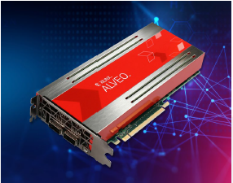
Xilinx Alveo Card
Overview (U250)
  Designed to meet changing needs of the modern Data Center, providing up to 90X performance increase over CPUs for common workloads
  Provide reconfigurable acceleration that can adapt to algorithm optimizations, supporting any workload type while reducing overall cost of ownership
Highlights
  Fast
    Up to 90X higher performance than CPU
    Over 4X higher inference throughput and 3X latency advantage over GPU-based solution
  Adaptable
    Machine learning inference, video process, etc
    Using reconfigurable hardware to adapt faster than fixed-function accelerator card product cycles
  Accessible – Cloud ↔ On-Premises Mobility
    Deploy solutions in the cloud or on-premises interchangeably, scalable to application requirements
    Applications available for common workloads, or build your own with the application developer tool
Notes:
Process data faster – 머신러닝, 비디오 처리, 데이터 분석

Slide 47
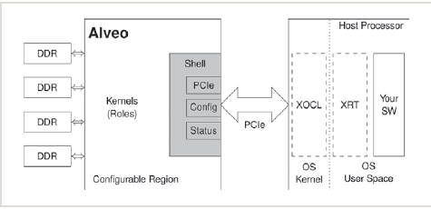
Xilinx Alveo Card
Alveo overview
  Divide into 3 parts
    Strong FPGA or ACAP to accelerate
    High bandwidth DDR4 memory bank
    High bandwidth PCIe Gen3 x16 link connectivity
  Alveo design can be sperate by shell & role
    Shell: Contain external link, configuration, and all static functions
    Role: Filled with custom logic to implement specific Algorithm
Notes:
Process data faster – 머신러닝, 비디오 처리, 데이터 분석

Slide 48
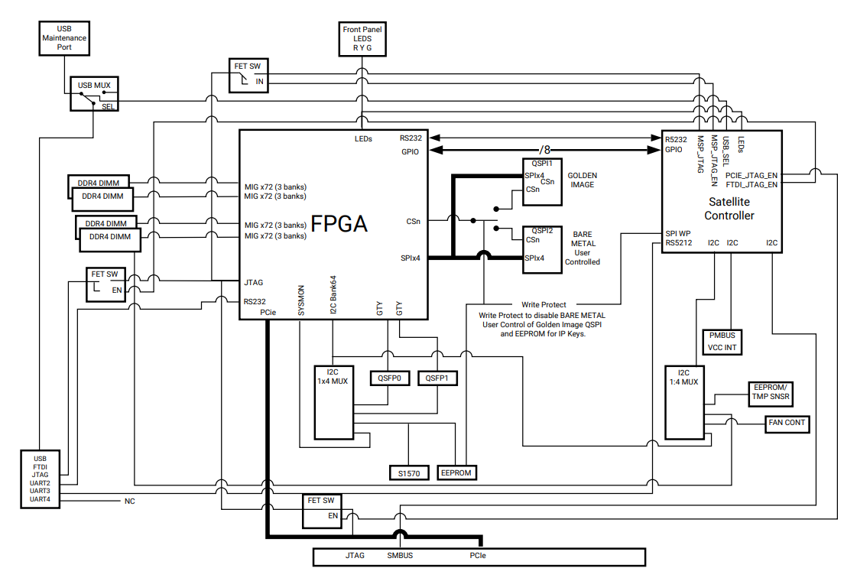
Xilinx Alveo Card
Alveo Architecuture (U250)
  Virtex UltraScale+ XCU250
  FPGA
Notes:
Process data faster – 머신러닝, 비디오 처리, 데이터 분석

Slide 49
Xilinx Alveo Card
Alveo Architecuture (U250)
  DDR4 Memory
    64GB DDR4 memory
    4x DDR4 16GB, 2400MT/s
    64bit with ECC DIMM
Notes:
ECC DIMM; Error correcting Code DIMM 일반적인 종류의 내부 데이터 손상을 감지하고 수정하는 기억 장치의 일종이다.

Slide 50
Xilinx Alveo Card
Alveo Architecuture (U250)
  Configuration options
    1GB QSPI Flash memory
    (Quad Serial Peripheral Interface)
    Micro-AB USB JTAG
    configuration port
Notes:
QSPI: 동기 직렬 방식의 interface, 거리가 짧으나 고속으로 통신 가능, Half-Duplex 방식을 이용, 한 번에 4개의 데이터 선을 이용해 병렬 전송(빠른 OS)

Slide 51
Xilinx Alveo Card
Alveo Architecuture (U250)
  PCIe
    16-lane (x16) Gen 1, 2, 3
Notes:
QSPI: 동기 직렬 방식의 interface, 거리가 짧으나 고속으로 통신 가능, Half-Duplex 방식을 이용, 한 번에 4개의 데이터 선을 이용해 병렬 전송(빠른 OS)

Slide 52
Xilinx Alveo Card
Alveo Architecuture (U250)
  Satellite Controller
    Providing independent supervisory,
    card management functions
    including power, temperature monitoring.
    Host server board management controller (BMC)
    interact with the satellite controller
    to monitor and control the card
    through out-of-band communication
Notes:
Qsfp: 데이터 통신에 사용되는 작고 핫 플러그가 가능한 트랜시버, 1Gbps 데이터 속도를 지원하는 광모듈

Slide 53
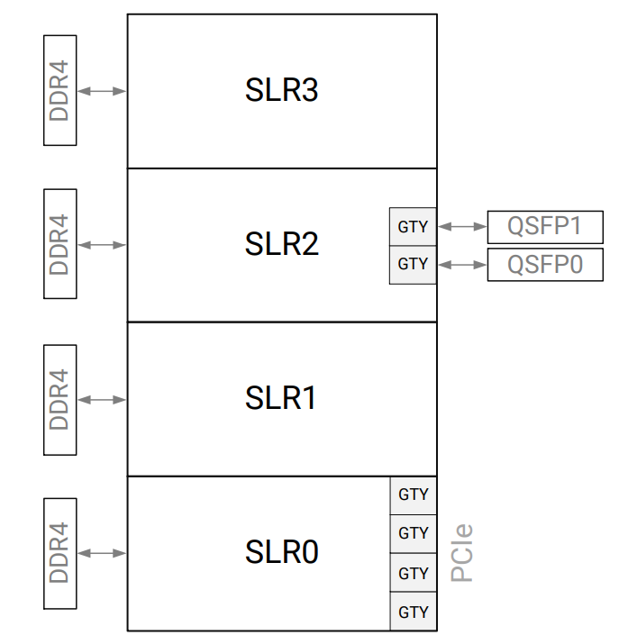
Xilinx Alveo Card
Inside the FPGA (XCU250)
  Dynamic Region
    Available for creating custom Accelerators
  SLR (Super Logic Region)
    Single device die slice contained in an SSI technology device
    Each SLR contains subset of device resources (CLB, BRAM, DSP)
    Multiple SLR components stacked vertically
    connected through interposer to create an SSI technology device
Notes:
Qsfp: 데이터 통신에 사용되는 작고 핫 플러그가 가능한 트랜시버, 1Gbps 데이터 속도를 지원하는 광모듈

Slide 54
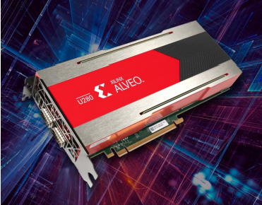
Xilinx Alveo Card
Overview (U280) – Difference from U250
  Offering 8GB of HBM2 up to 460 GB/s bandwidth to provide high-performance
  Including PCI Express 4.0 with CCIX support to leverage the latest server interconnect infrastructure for high-bandwidth, low latency
Highlights
  Fast
    Up to 3000X higher throughput than CPU
    Over 8X faster response time for database SQL TPC-H Query 5
  Adaptable
    natural language processing to any workload using the same accelerator card
    Using reconfigurable hardware to adapt faster than fixed-function accelerator card product cycles
  Accessible – Cloud ↔ On-Premises Mobility
    Deploy solutions in the cloud or on-premises interchangeably, scalable to application requirements
    Applications available for common workloads, or build your own with the application developer tool
Notes:
TPC-H: 벤치마크 프로그램

Slide 55
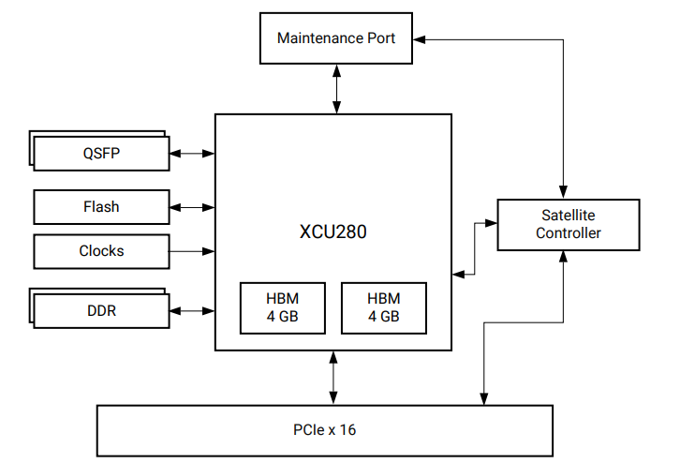
Xilinx Alveo Card
Alveo Architecuture (U280)
  Virtex UltraScale+ XCU280
  FPGA
Notes:
ECC DIMM; Error correcting Code DIMM 일반적인 종류의 내부 데이터 손상을 감지하고 수정하는 기억 장치의 일종이다.

Slide 56
Xilinx Alveo Card
Alveo Architecuture (U280)
  DDR4 Memory
    32GB DDR4 memory
    2x DDR4 16GB, 2400MT/s
    64bit with ECC DIMM
  HBM DRAM Memory
    Two HBM Memories in FPGA
Notes:
ECC DIMM; Error correcting Code DIMM 일반적인 종류의 내부 데이터 손상을 감지하고 수정하는 기억 장치의 일종이다.

Slide 57
Xilinx Alveo Card
Alveo Architecuture (U280)
  PCIe bus
    CCIX and PCIe Gen 4 can be supported
Notes:
ECC DIMM; Error correcting Code DIMM 일반적인 종류의 내부 데이터 손상을 감지하고 수정하는 기억 장치의 일종이다.

Slide 58
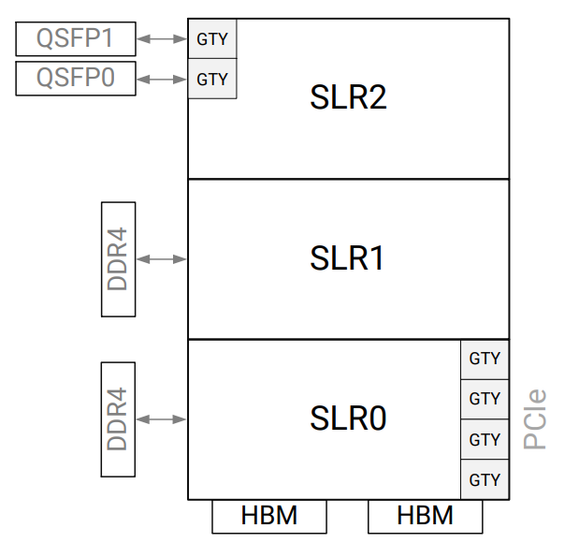
Xilinx Alveo Card
Inside the FPGA (XCU250)
  Integrating HBM controller to interface
    Two adjacent 8GB HBM2 memory
Notes:
GTY: 고속 시리얼 인터페이스

Slide 59
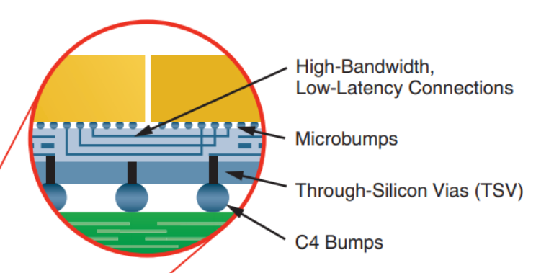
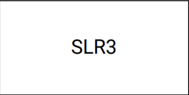
Xilinx Alveo Card
Understanding FPGA Components
  SSI (Stacked Silicon Interconnect): Die connecting Technology
    Enable high bandwidth between SLRs, minimizes delays in data transmission
  SLR: Single Die in FPGA
    Vertically integrated in FPGA
    6-input LUTs, Registers, I/O components, Gigabit Transceivers (GT)
    Block memory, DSP blocks, Other blocks
  Clock Region
    By growing size of FPGA, clock skew control is important
    SLR can be split into boxes which contain CLBs
Notes:
언급만! / U280, CCIX

Slide 60
PCI-e
Notes:
Channel은 Bank로, Bank는 다수의 Memory Array들로 구성되어 있는 모습을 확인할 수 있다.

Slide 61
PCI-e
High-speed serial computer expansion bus standard
  In the case of parallel communication, there is an issue (EMI) that is difficult to implement high clock frequency
Full duplex communication between end-points
  Bandwidth increase
Compatible for Previous versions of PCI-e and Legacy PCI
Multiple lanes (x1, x2, x4, x8, x12, x16, x32) exist.
  Each lane's signal is asynchronously transmitted with clock information in the data stream
It consists of three layers. Data communication in packet form for each layer
Point-to-Point

Slide 62
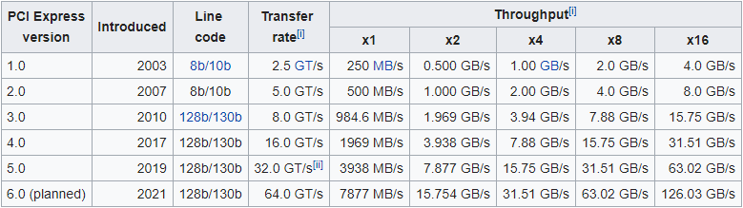
PCI-e
After Gen3, the encoding method is improved to 8b/10b -> 128b/130b, increasing bit per transfer
Throughput increases linearly for lane

Slide 63
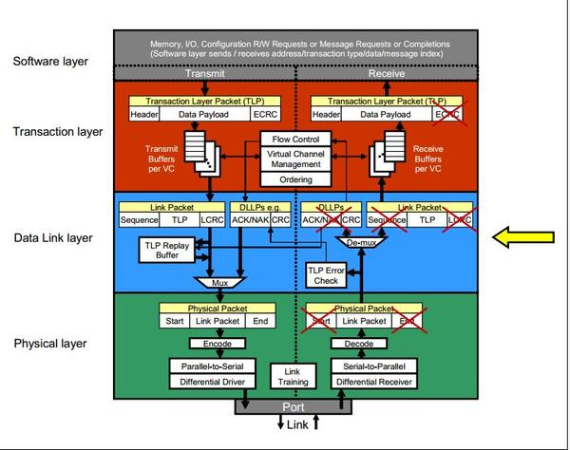
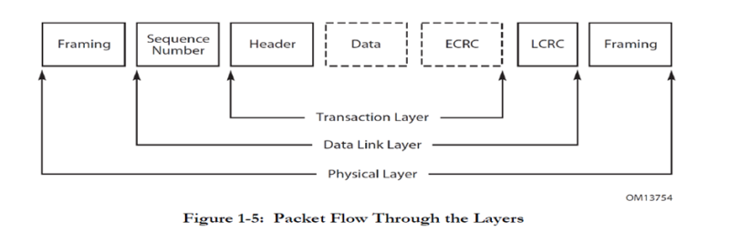
PCI-e Layer
Configured with 3 layers except Software layer
Add a header and tail for each layer, packetize the data, and send it

Slide 64
Software / Transaction Layer
Software layer is at the top of the layer
  No separate header and tail are added (not included in the layer)
  Destination or start point of all requests
  Endpoint (CPU, Memory, etc.)
In the Transaction Layer, inbound/outbound packets are generated/transmitted based on requests from the software layer (TLP, Transaction Layer Packet).
  QoS(Quality of Service)
    By assigning priority to packets, the quality of data transmission can be ensured.
    The priority is determined through the Traffic Class (TC, 3-bit) field.
  To implement error detection, the packet includes ECRC (End-to-End Cyclic Redundancy Check).

Slide 65
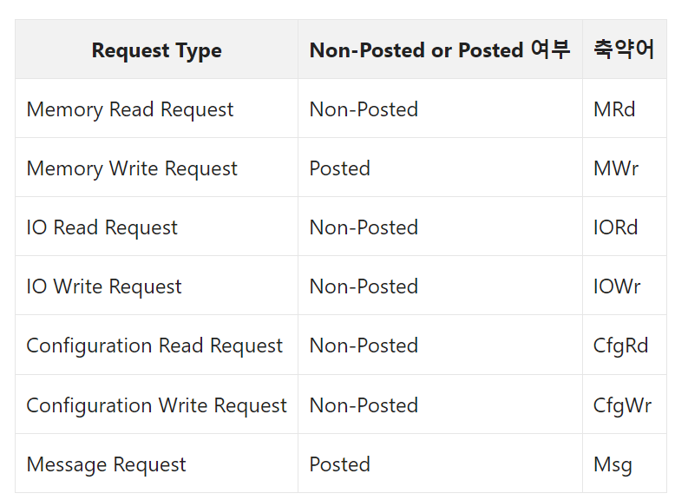
Transaction Layer
For each Request Type, a separate Address space is used, including a total of 4 types: Memory, IO, Configuration, and Message.
The packet composition varies depending on the Request Type. In the case of non-Posted transactions, the receiving side generates a Completion packet.
The Configuration type contains information such as Device ID, Vendor ID, and Class code, which are stored in PCI-e capable devices.
The Message type is used to transmit events such as interrupts, power management events, and errors along the path of the packet. It helps reduce the number of pins required for communication.

Slide 66
Data Link Layer
TLP (Transaction Layer Packet) performs various roles such as error correction, flow control, and link power management.
Error correction
  Error correction is hardware-based and involves adding LCRC (Link Cyclic Redundancy Check) and Sequence Number to DLLP (Data Link Layer Packet) for this purpose.
  After error correction, the receiving side sends Ack/Nack signals to the transmitting side through DLLP based on the received result. The transmitting side stores the data in a retry buffer until an ack signal is received.
Flow control
  Flow control involves checking the status of the buffer for data reception to prevent sending TLPs beyond the available buffer capacity.
Power management
  Power management includes monitoring the Link and system power states, such as L0, L0s, and L1.

Slide 67
Physical Layer
The layer where actual transmission takes place is the Physical Layer.
It performs the task of adding Start and End to DLLP (Data Link Layer Packet).
Packets are divided into lane, known as byte striping, for transmission.
In order to reduce EMI (Electro-magnetic Interference), repetitive patterns are minimized.

Slide 68
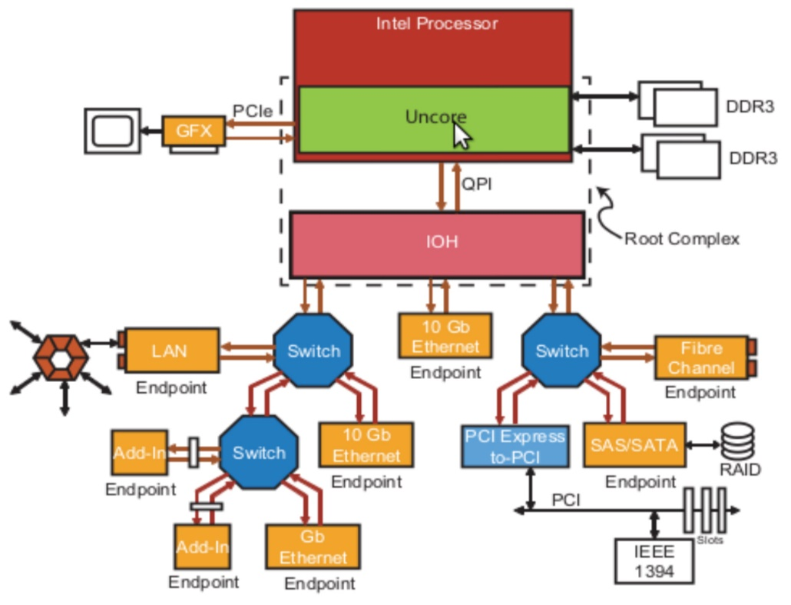
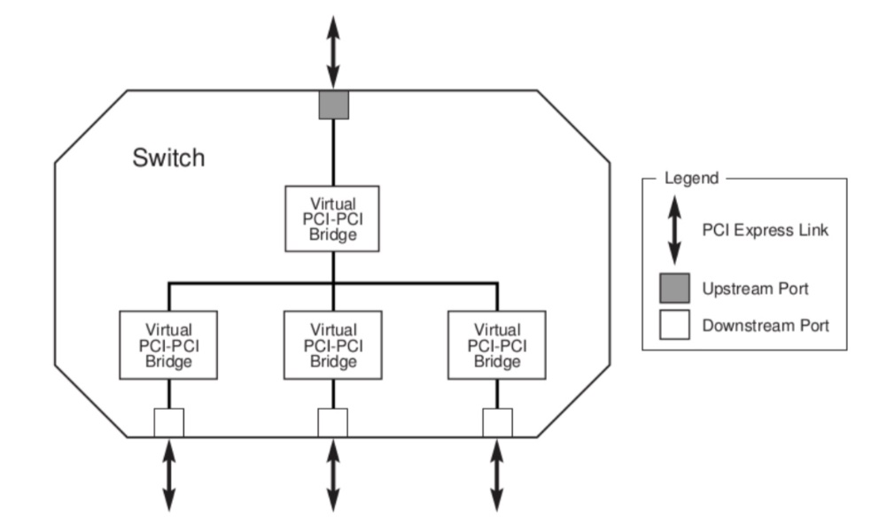
PCI-e topology
Root complex
  It has multiple downstream ports (PCI bridges).
  It has one upstream port (host bridge).
  The downstream ports can be connected to switches or endpoints.
Switch
  A single root port can connect multiple devices.
  It acts as a packet router, recognizing the address of the packet and using other routing information to determine the path the packet should take.
Brdige
  interface between different buses(pci – pcie)

Slide 69
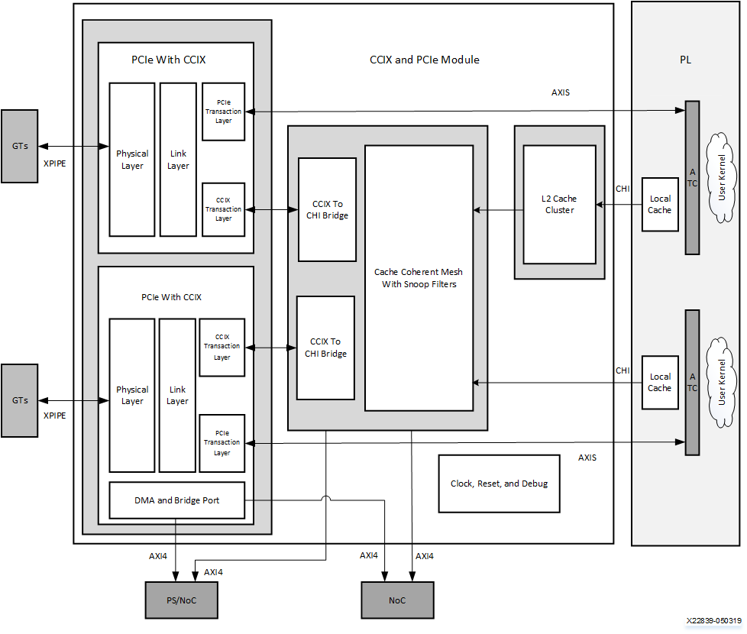
CCIX
The Cache Coherent Interconnect for Accelerators (CCIX) is an adopted protocol designed to leverage the high memory bandwidth of U280 HBM
CCIX ensures cache coherence between the host processor and accelerator at the hardware level, reducing latency compared to traditional DMA-based cache coherence policies.
In the case of U280, it utilizes PCIe Gen4.0 x8, operating at 16 GT/s x8, to provide a high-speed interconnect between the host processor and accelerator.

Slide 70
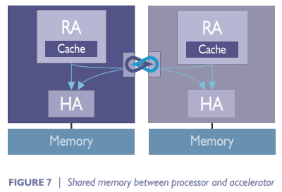
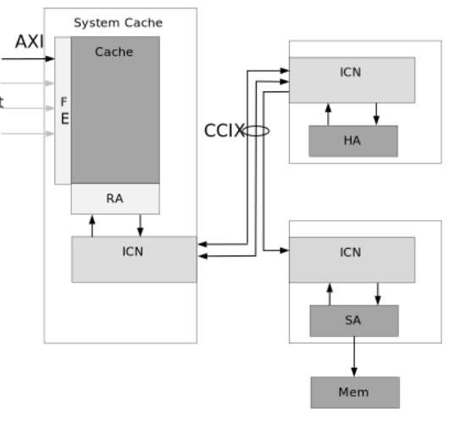
CCIX Agent
Request Agent
  Performs read and write transactions to different addresses within the system and cache locations that it has accessed.
Home Agent
  Managing coherency and access to memory for a pre-determined address range.
  Sending snoop transactions to the required Request Agents when a cache state change.
    Snoop filter(SF) : keeps track of addresses mapped to local memory that have been cached by caches in the system
Slave Agent
  when the Home Agent resides on one chip and some or all of the physical memory associated with the Home Agent resides on a separate chip
  Always accessed through HA.

Slide 71
Xilinx VITIS HLS
Notes:
Channel은 Bank로, Bank는 다수의 Memory Array들로 구성되어 있는 모습을 확인할 수 있다.

Slide 72
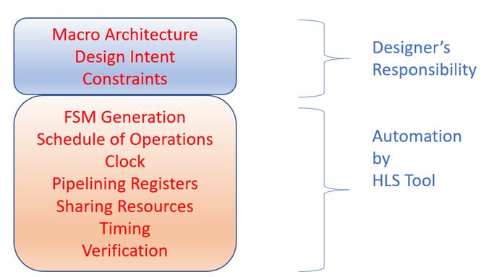
HLS
High-Level Synthesis (HLS)
  automated design process that takes an abstract behavioral specification of a digital system and generates a RTL structure.
  designer needs to create the macro-architecture of the algorithm in C/C++ at a high level and provide input constraints (clock period, performance constraints, etc.)
  Micro-architecture decisions like creating the state machine, datapath, register pipelines, etc are not needed at a high level.

Slide 73
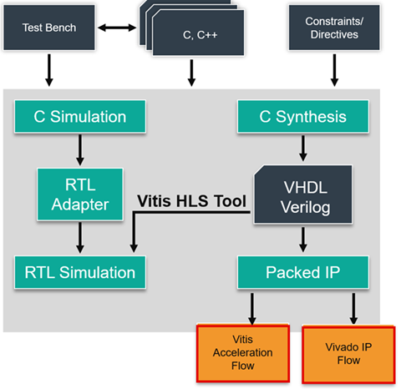
HLS
Architect the algorithm based on the Design Principles
(C-Simulation) Verify the C/C++ Code with the C/C++ testbench
(C-Synthesis) Generate the RTL using HLS
(Co-Simulation) Verify the kernel generated with C++ outputs
(Analyze) Review the HLS synthesis reports and co-simulation reports, analyze
Re-run previous steps until performance goals are met.

Slide 74
Re-Architecting the Design Code
Hardware Interfaces
  In the top-level design, parameters are typically passed from the HW through interfaces. Vitis HLS automatically determines the interfaces, but you can override them by specifying the INTERFACE pragma.
Controlling the Execution of HLS Design
  The RTL module requires control signals to operate. The module's operation is determined by signals determined by the block-level control protocol.
Task-Level Parallelism
  In order to increase performance, the defined operations in HLS need to be amenable to parallel processing.
  Vitis HLS tool offers multiple types of task-level parallelism (TLP).

Slide 75
Re-Architecting the Design Code
Memory Architecture
  Access to global memory has higher latency costs and can take many cycles while access to local memory is often quick
  Often the memory is allocated/deallocated dynamically in a C++ program but this can't be synthesized in hardware.
  The burst access hides the memory access latency and improves the memory bandwidth.
Micro Level Optimization
  Vitis HLS can unroll, or pipeline a loop or nested loops by inserting pragmas at appropriate levels in the source code.
  Pragma is needed such as PIPELINE, UNROLL, ARRAY_PARTITION, PERFORMANCE , etc.

Slide 76
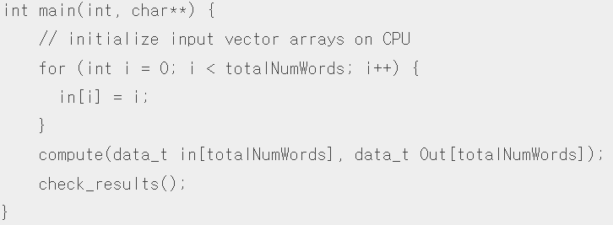


Example Re-Architecting the Design Code

Slide 77




Example Re-Architecting the Design Code

